Slide 1
C++ Programming(Exercise) 9
Arne Kutzner
Hanyang University / Seoul Korea

Slide 2
Polymorphism
An object of a subclass can be used in any code designed to work with an object of its superclass.
Example)
Q:What area() implementation we use here?
void main(){
Cylinder* cyl = new Cylinder(10, 5);
Circle* cir = new Circle(9);
Circle* cir1 = cyl; // Where we use polymorphism
std::cout << cir1 -> area();
}

Slide 3
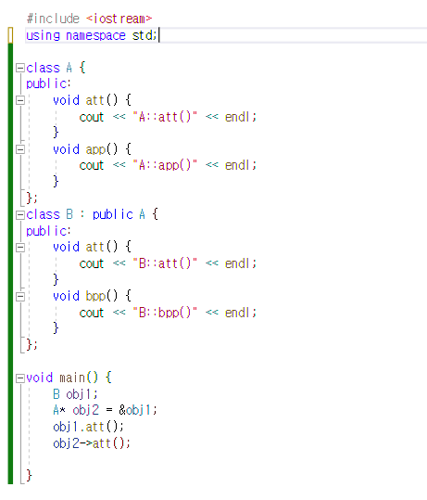
Polymorphism(Example)

Slide 4
Dynamic Binding
It is decided during runtime, which implementation has to be used
Example:
void main(){
Cylinder* cyl = new Cylinder(10, 5);
Circle* cir = new Circle(9);
Circle* cir1 = cyl;
std::cout << cir1 -> area(); // Because of dynamic binding, Cylinder implementation of area() is used here.
}

Slide 5
Virtual function
A method in some base class using dynamic binding, and occurs when overridden by some subclass.
Defined by keyword ‘virtual’
Defined in public class
It can’t be static, and can’t be a friend function.
To get polymorphism, it should be accessed by pointer of the base class.

Slide 6
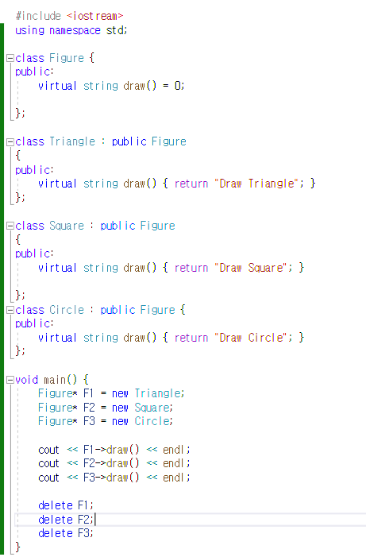
Virtual function(Example)

Slide 7
Exception Handling
Language without Exception handling:
Programmers should take care of implementing error detection/recovery mechanism.
Language with Exceptional Handling:
Programs can trap specific errors by using exceptions, thereby providing the possibility of fixing program and continuing.
It separates error-handling code from other programming tasks., which makes programs much easier to read and to modify.

Slide 8
Exception Handling(Continue)
Exception: any unusual event(either erroneous or not), which is detectable by either software/hardware, that may require a special processing.
This special processing is called Exception Handling, and exception handling code unit is called an Exception Handler.

Slide 9
Exception Handling(Continue)
To handle exception, there are some expressions used to disambiguate exceptions.
Example)
throw expression;
Try-Catch: In ‘Try’, this block checks whether exception occurred or not. In ‘Catch’, this block catches the exception occurred in try block, and handles exception in this block.

Slide 10
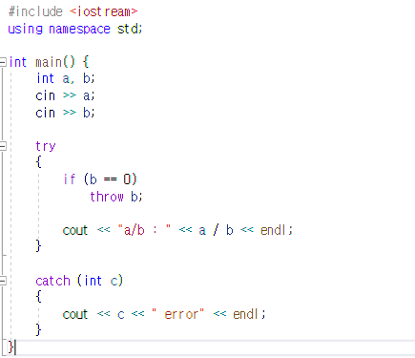
Try-Catch, throwing

Slide 11
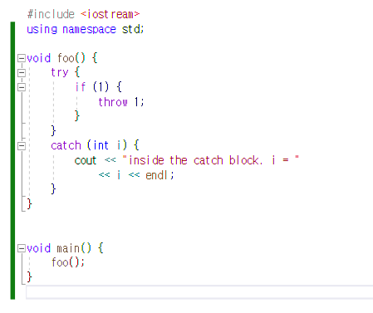
Try-Catch, throwing

Slide 12
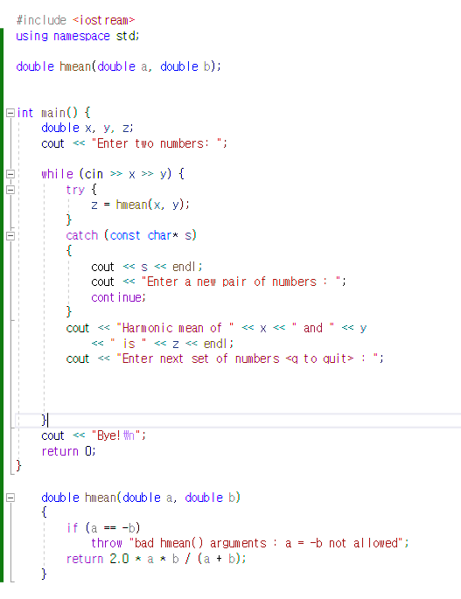
Try-catch, throwing(Continue)

